Slide 1
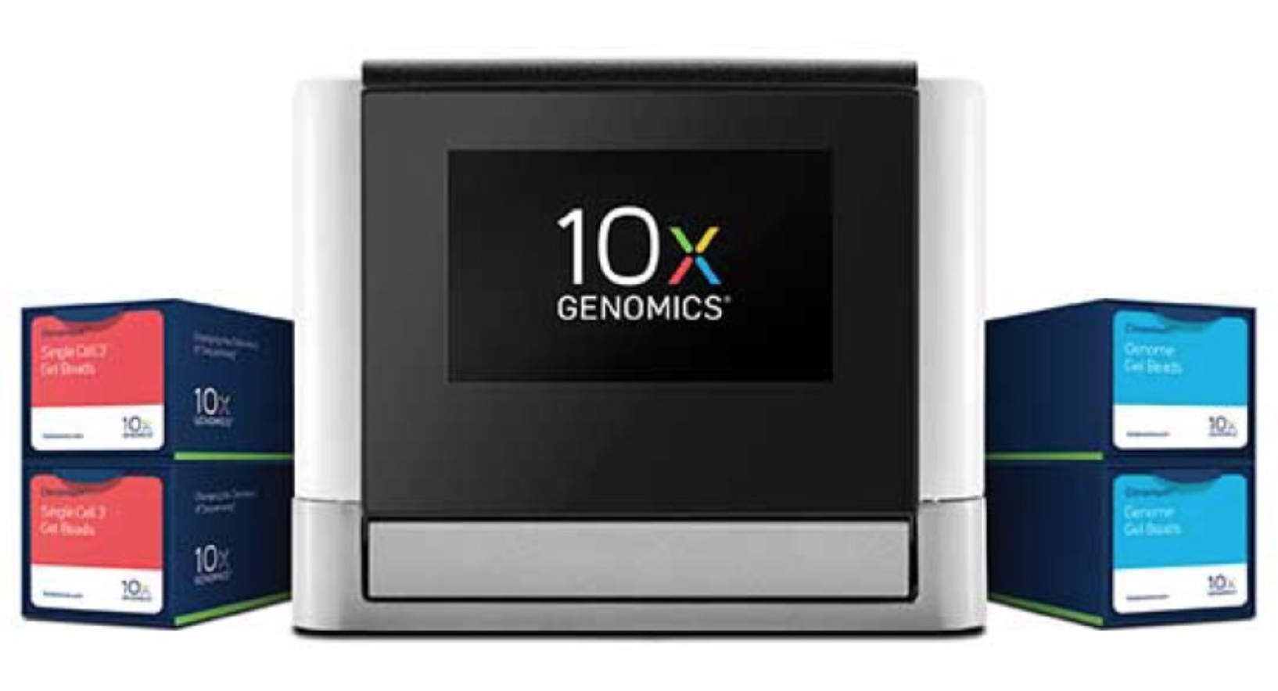
Will 10x technology make us rethink genome assemblies?

Slide 2
What 10x is currently used to do
Genome –– Genome Resequencing
Call the full spectrum of variants (particularly long INDELS/CNV and structural variants) and unlock previously inaccessible regions from a single library at equivalent coverage as standard genome resequencing projects
Exome – Subselect reads using capture techniques (Agilent)
Enable phasing of genes and detection of structural and copy number variation
Agilent SureSelect baits improve gene phasing by closing gaps, and recovering hard-to-map loci in the genome (future kits to include previously failed regions)
Assembly – de Novo genome assembly
Single Cell 3’ RNAseq
High-throughput single cell RNA sequencing
Scalable transcriptional profiling of 1,000s to 10,000s of individual cells

Slide 3
Genome and Exome Analysis
Long-range analysis and phasing of SNVs, indels, and structure variants

Slide 4
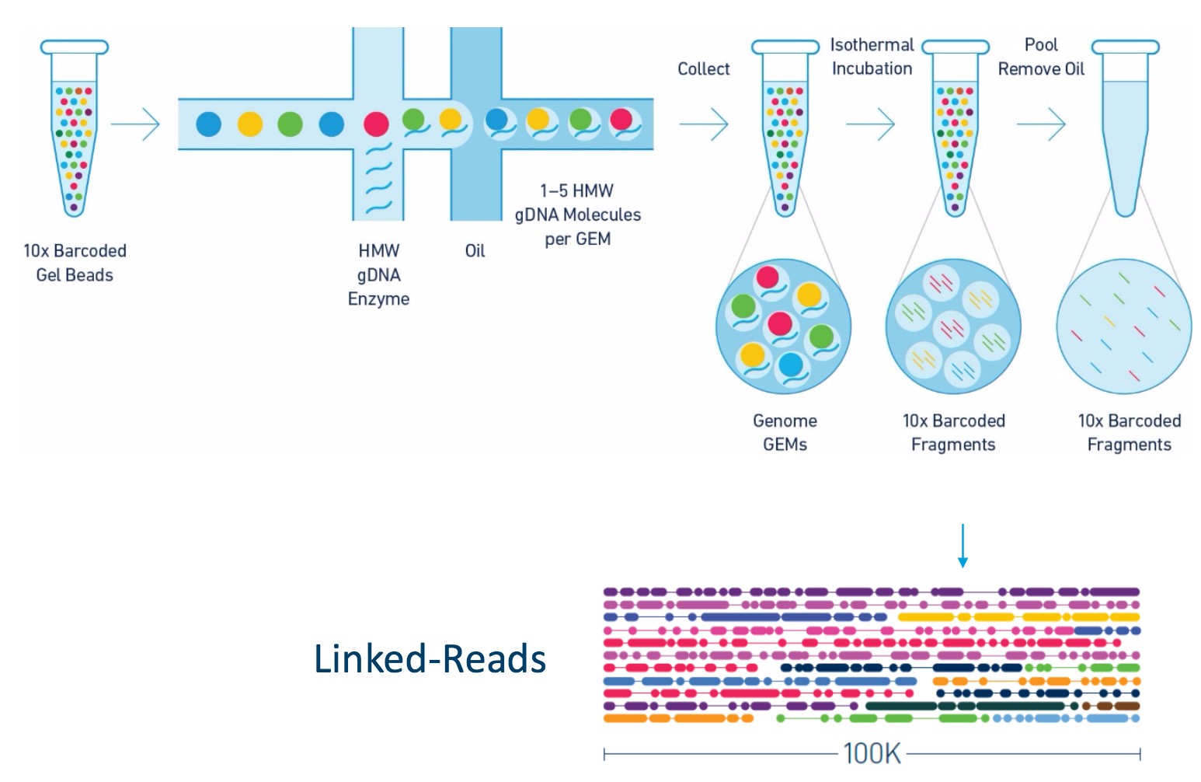
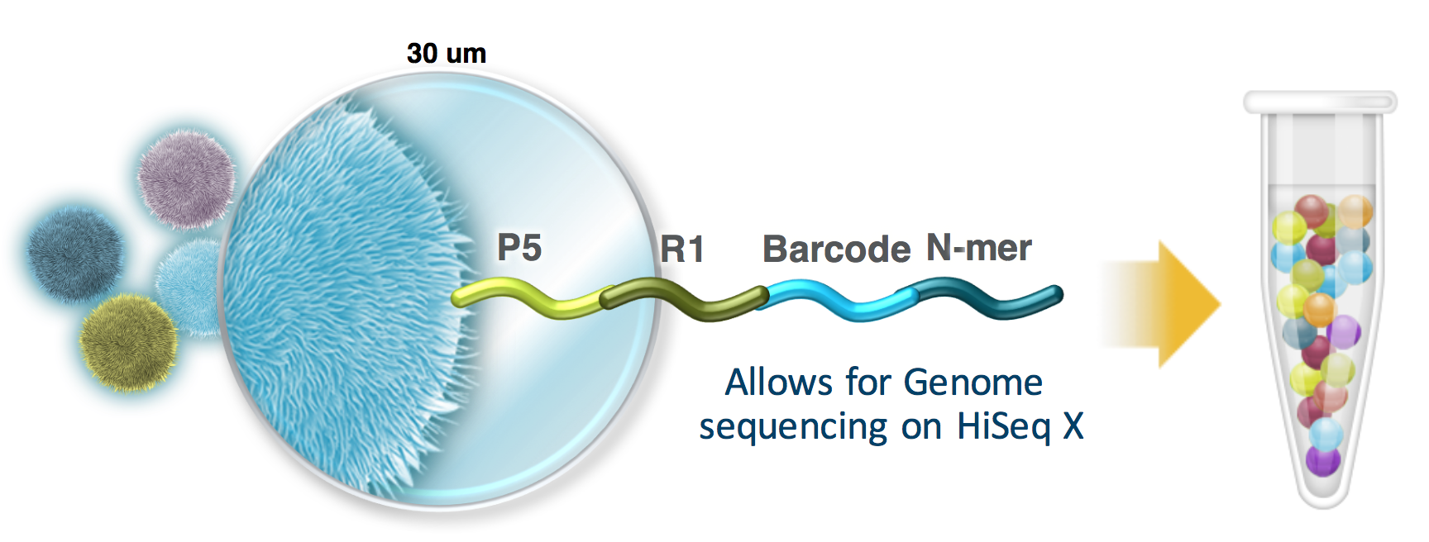
In a nut shell

Slide 5
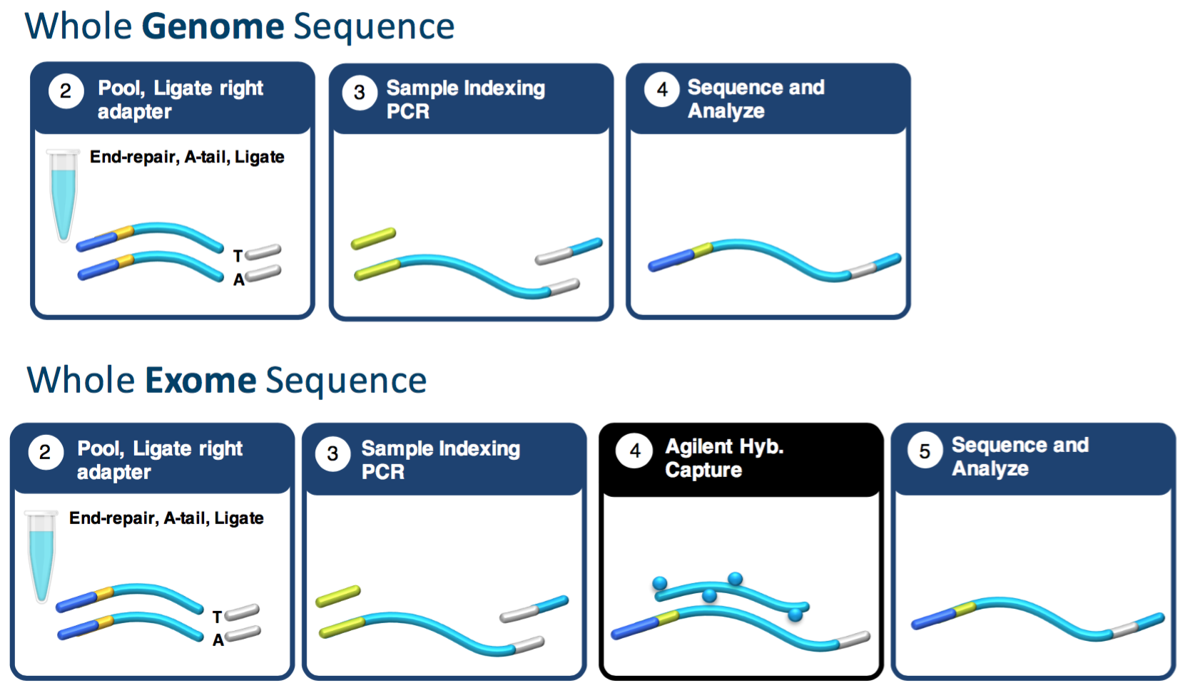
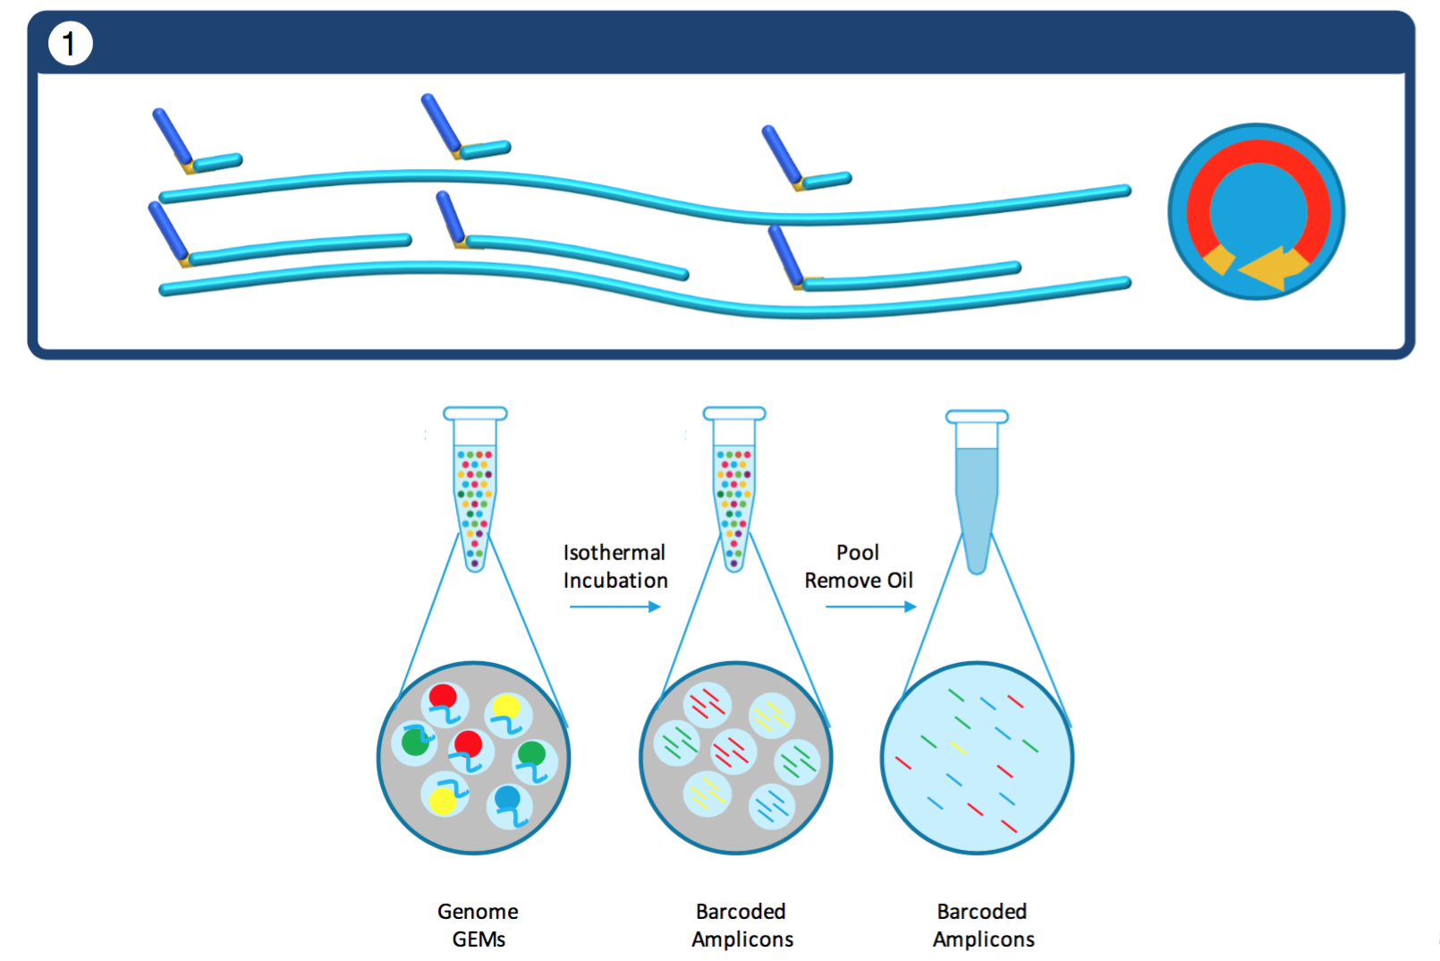
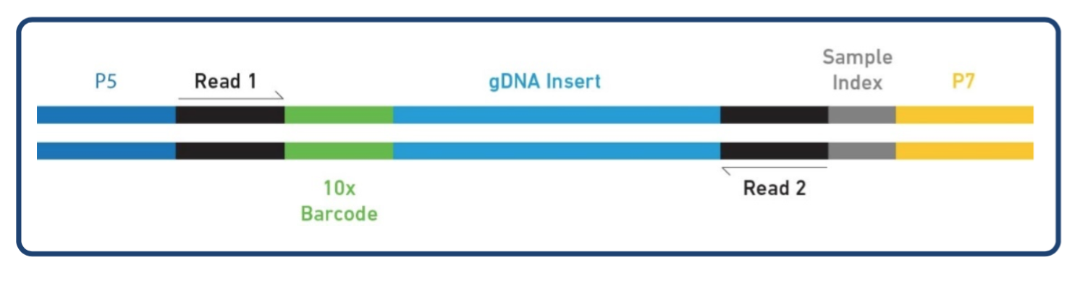
Laboratory Workflow
Shear?
8-bp Sample Index
16-bp 10x Barcode
7-bp N-primer (?)

Slide 6
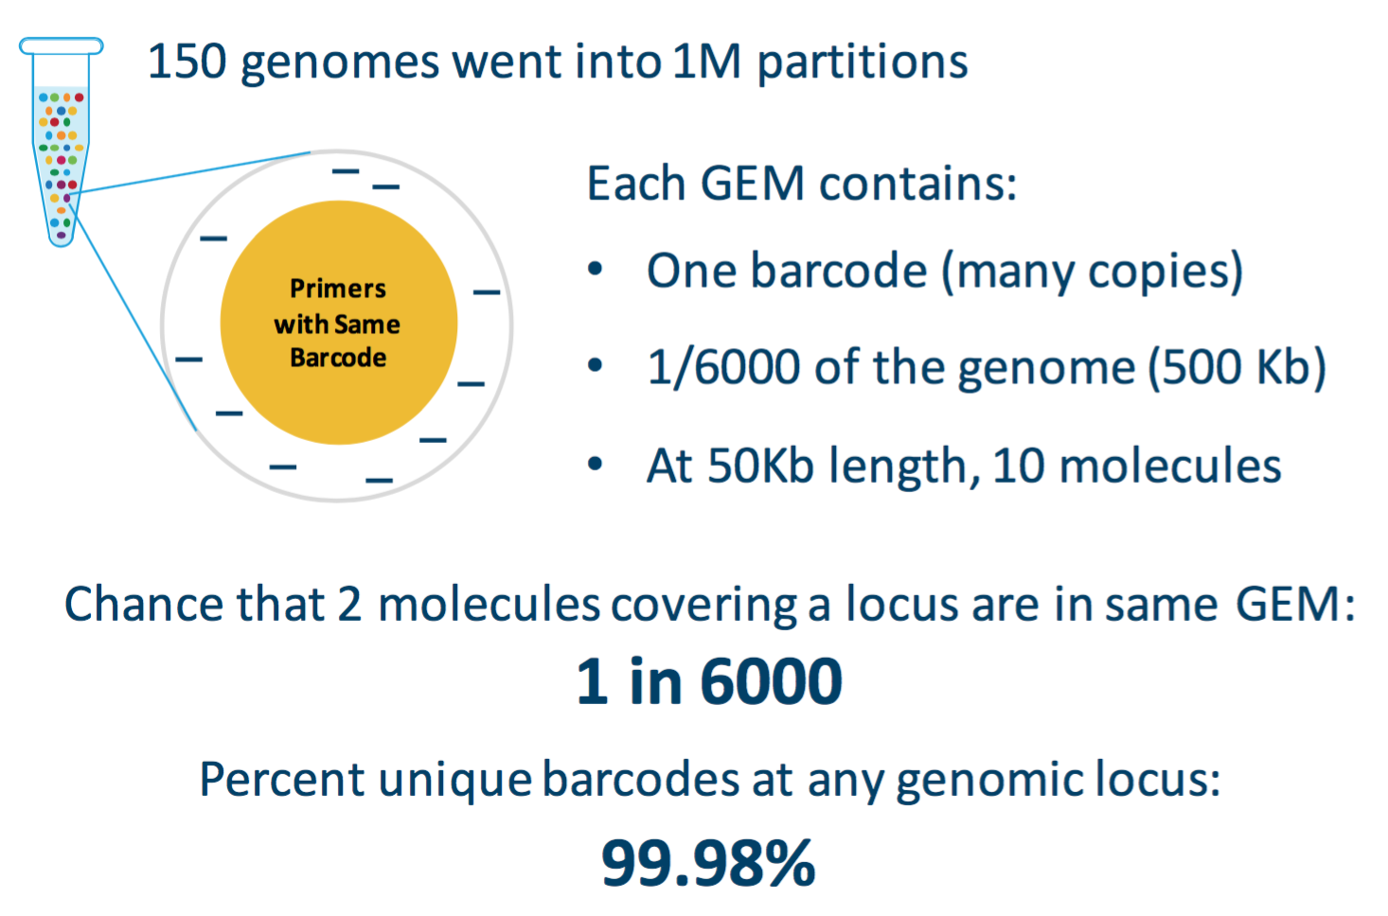
The Math
1 ng Input DNA = 300 genomes copies of the genome
Calculations imply that about 50% of all possible fragments end up in a bead

Slide 7
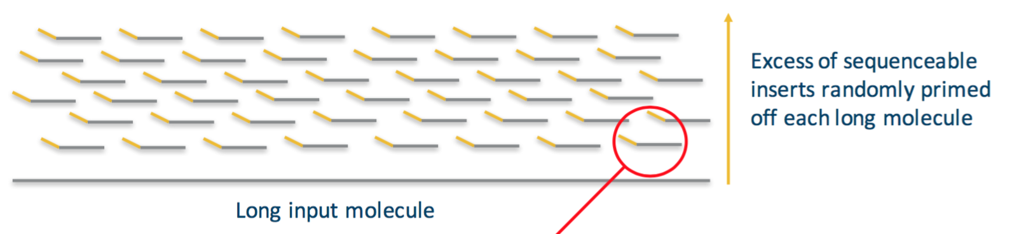
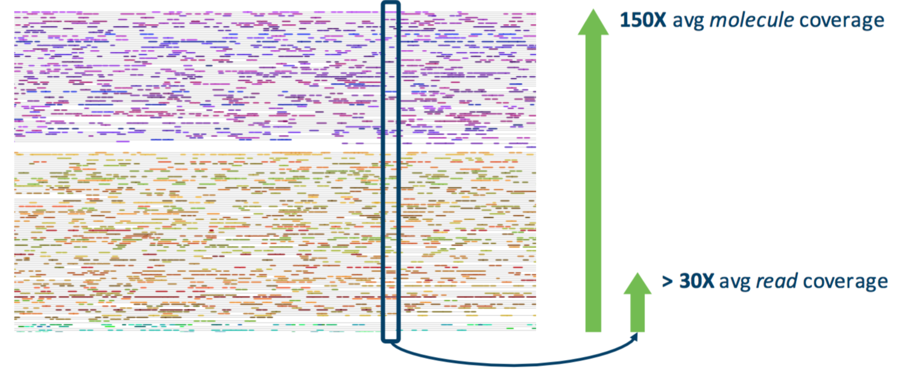
@ Recommended Loading
Each locus will have 150 molecules
Each locus will have 30x read depth
~35 fragments per molecule
@50Kb molecules = 0.2x/molecule

Slide 8
LPM – Linked Reads per molecule
LPM = N/M
N=Total Sequenced Reads
M=Molecules into System
N = (G x C)/L
G=Genomic size (bases)
C=Coverage [target 60x coverage for Supernova]
L=Read Length [ 300, for 2x150bp reads]
M = (G x N_{G})/S
G=Genomic size (bases)
N_{g}=Number of Haplotype Genomes [for human 1ng @3.2Gb = 150 haplotype genomes]
S=Fragment size of molecules (bases) [Avg Fragment size, ex. 50kb]
LPM = C/L x S/N_{G} = 60/300 x 50,000/150 = 67 linked reads per molecule
(Human at 1ng input)

Slide 9
As the Chromium Controller utilizes a haplotype limiting dilution, genome size must be taken into account before starting an experiment. Report testing 1Gb to 3.2Gb genome
Haplotype limiting dilution is the proportion of a genome within each bead. The higher the dilution the more likely two fragments within the same bead will overlap.
In general, larger mammalian genomes, such as mouse should work fine in the Chromium System.
The smaller the genome, the smaller the amount of DNA that must be loaded to maintain a haplotype limiting dilution
10X Genomics recommends loading 1-1.2 ng of HMW (avg 100kb) human DNA into the Chromium Controller

Slide 10
Smaller Genomes
For smaller genomes, assuming that the same DNA mass was loaded and that the library was sequenced to the same read­depth, the number of Linked­Reads (read pairs) per molecule would drop proportionally, which would reduce the power of the data type. For example, for a genome whose size is 1/10th the size of the human genome (320 Mb), the mean number of Linked­Reads per molecule would be about 6, and the distance between Linked­Reads would be about 8 kb, making it hard to anchor barcodes to short initial contigs. Modifications to workflow, such as loading less DNA and/or increasing coverage would be potential solutions for smaller genomes, but are not described here.

Slide 11
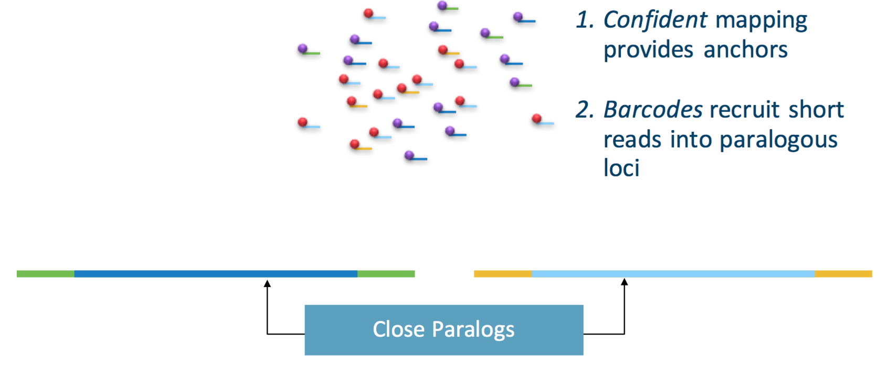
Increased Mapability

Slide 12
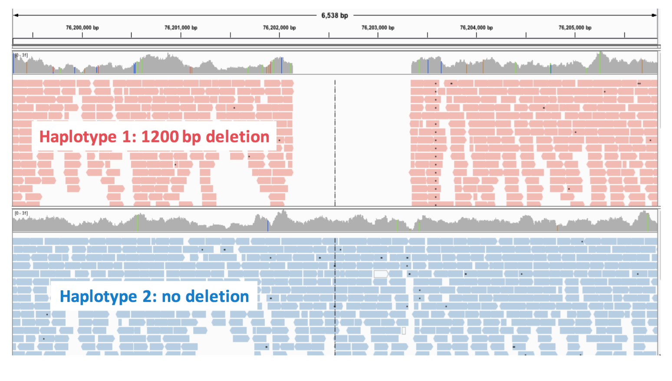
Linked Reads

Slide 13
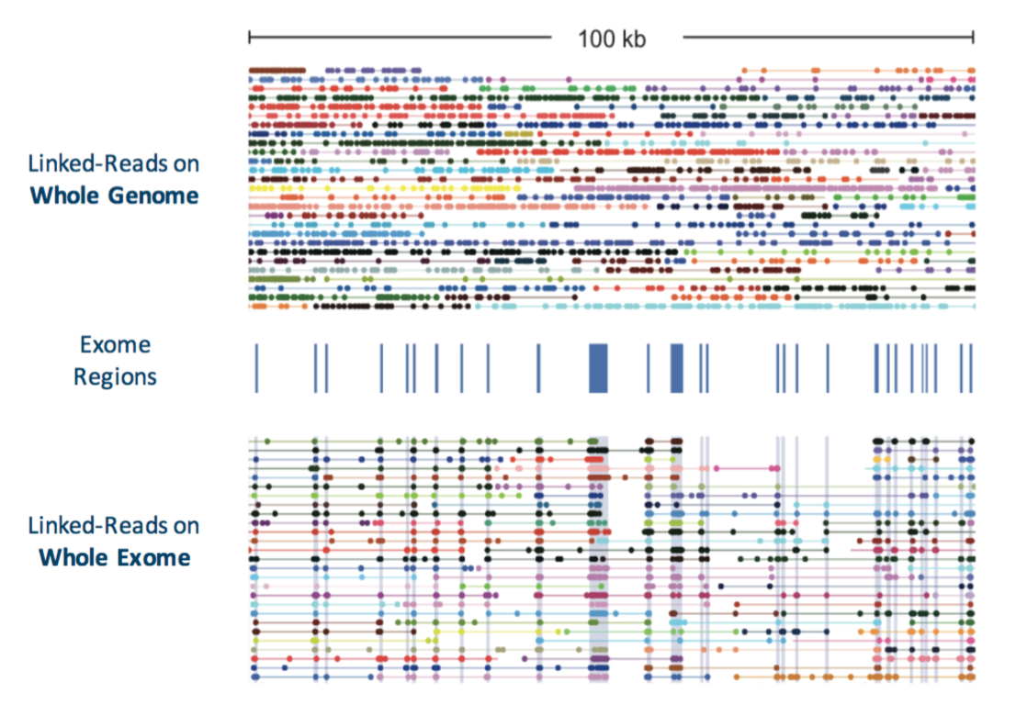
Capture – linked genes
Enrich reads of interest instead of random selection
Depending on size of capture, can pool more samples/lane

Slide 14
Assembly
de novo assemblies

Slide 15
Sample Requirements - Supernova
Genome size: Supernova has been tested on genomes in the size range 1.0-3.2 Gb.
Other genome characteristics: Supernova has not been tested on genomes having repeat content far greater than human, nor on genomes having extreme GC content.
Clonality: strongly recommend that DNA be obtained from an individual organism or clonal population.
DNA size: Recommend that this value be at least 50 kb, and preferably 100 kb. DNA length is highly correlated with several assembly statistics, including contig length, phase block length and scaffold length.

Slide 16
Sequencing - Supernova
Instrument | Configuration | Result | Lanes
HiSeq X | Standard | Excellent | 2
HiSeq 2500 | Rapid run | Excellent | 4
HiSeq 2500 | High Output | Not tested
HiSeq 4000 | Standard | Useable, but observed contig length half as long as those from HiSeq X | 2
Miseq | standard | Not tested
Read length: Supernova requires as input 2x150 base reads.
Sequencing depth: Recommends sequencing to depth between 38x and 56x. For highly polymorphic organisms, we recommend 56x. Coverage higher than 56x may not improve results. Sequence twice as much as mapping application

Slide 17
System Requirements - Supernova
16-core (or greater) Intel or AMD processor
384 GB RAM
2 TB free disk space
64-bit CentOS/RedHat 5.2+ or Ubuntu 8+
Bcl2fastq 2.17
No other large processes running on the system **
Supernova should be run with at most 1.2 billion reads (single reads),
and at 38-56x coverage of the genome.

Slide 19
Genome Stats
Genome | Size (Gb) | DNA size(Kb) | N50 contig(Kb) | N50 scaffold(Mb) | N50 phase block (Mb)
NA12878 | 3.2 | 95.5 | 85.0 | 12.8 | 2.8
NA24385 | 3.2 | 111.3 | 90.0 | 10.4 | 3.9
HGP | 3.2 | 138.8 | 104.9 | 19.4 | 4.6
Yoruban | 3.2 | 126.9 | 100.5 | 16.1 | 11.4
Komodo dragon | 1.8 | 85.4 | 95.3 | 10.2 | 0.4
Spotted owl | 1.5 | 72.2 | 118.3 | 10.1 | 0.2
Hummingbird | 1.0 | 86.2 | 87.6 | 12.5 | 10.1
Monk seal | 2.6 | 92.3 | 93.8 | 14.8 | 0.6
Chili pepper | 3.5 | 53.3 | 84.7 | 4.0 | 2.1

Slide 20
Genome Quality - Pac Bio vs 10x
Qualitatively
Pac Bio will produce >> N50 contig lengths (contiguous sequence) on the order of 10 – 50x larger contig N50
10x will will produce >> N50 scaffold length (ordered and arranged contigs with gaps) on the order of 2-5x larger scaffold N50
Costs
Human Genome sequenced at ~60x coverage
(recommended depth for both Pac Bio and 10x)
$70,000 Pac bio
$8,500 (4 lanes, HiSeq 2500 2x150, rapid mode) [~$5000 on the X platform]
Input DNA
10x requires ~ 1ng input DNA relative to ~10ug of input DNA for Pac Bio
Genome size for 10x 1gb-3gb (tested), no such limitation on Pac Bio

Slide 21
Supernova Assembler
Basic idea, based on DISCOVAR assembler + Linked Read information
Use Barcodes to first prefilter kmers
Using kmers (k=48bp), remover all kmers present in only 1 - 10x barcode
DISCOVAR de novo Assembly
Lines (discovar contigs, but with read info) are ordered and oriented using 10x barcode information. Creates bubbles and megabubbles.
Phasing then occurs by orientating each bubble on a line, placing one of its branches on ‘top’ and the other on the ‘bottom’. Iterative algorithm.

Slide 22
Supernova
supernova mkfastq
Supernova begins with bcl files, converting raw Illumina output to fastq files amendable to their assembly pipeline.
Mkfastq has a significant number of assumptions on how the run was performed.
Can use bcl2fastq directly to produce fastq files
https://support.10xgenomics.com/single-cell/software/pipelines/latest/using/bcl2fastq-direct
supernova run
Basically no parameters, just runs on fastq files
supernova mkoutput
run, megabubbles, pseudohap, pseudohap2

Slide 23
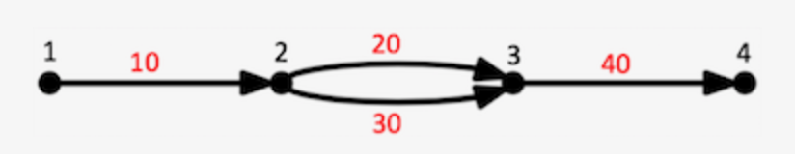
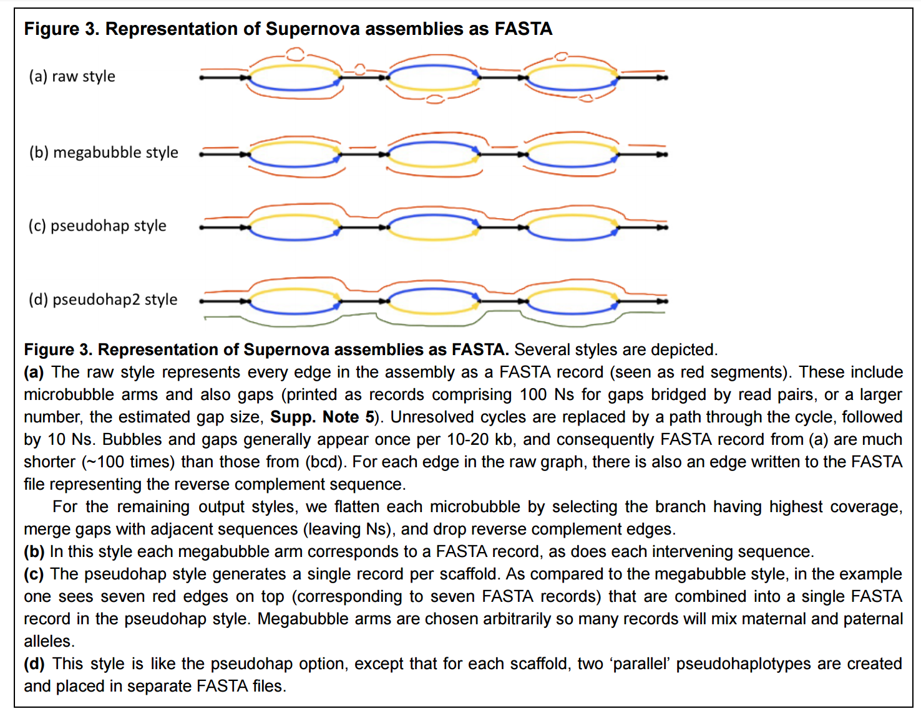
Supernova assemblies
>55 edges=10,20,40 left=1 right=4 ver=1.3 style=2 ACTTTAGACGGGGACCCTAGACTTACTTGAGAAAACGTTTTTACACTTACCA
Field | Sample Value | Meaning
edges | 10,20,40 | path of edges in the assembly that the sequence describes
left | 1 | identifier of vertex at left end of the path
right | 4 | identifier of vertex at right end of the path
ver | 1.3 | Supernova output format version number
style | 2 | output style identifier (see below)

Slide 24
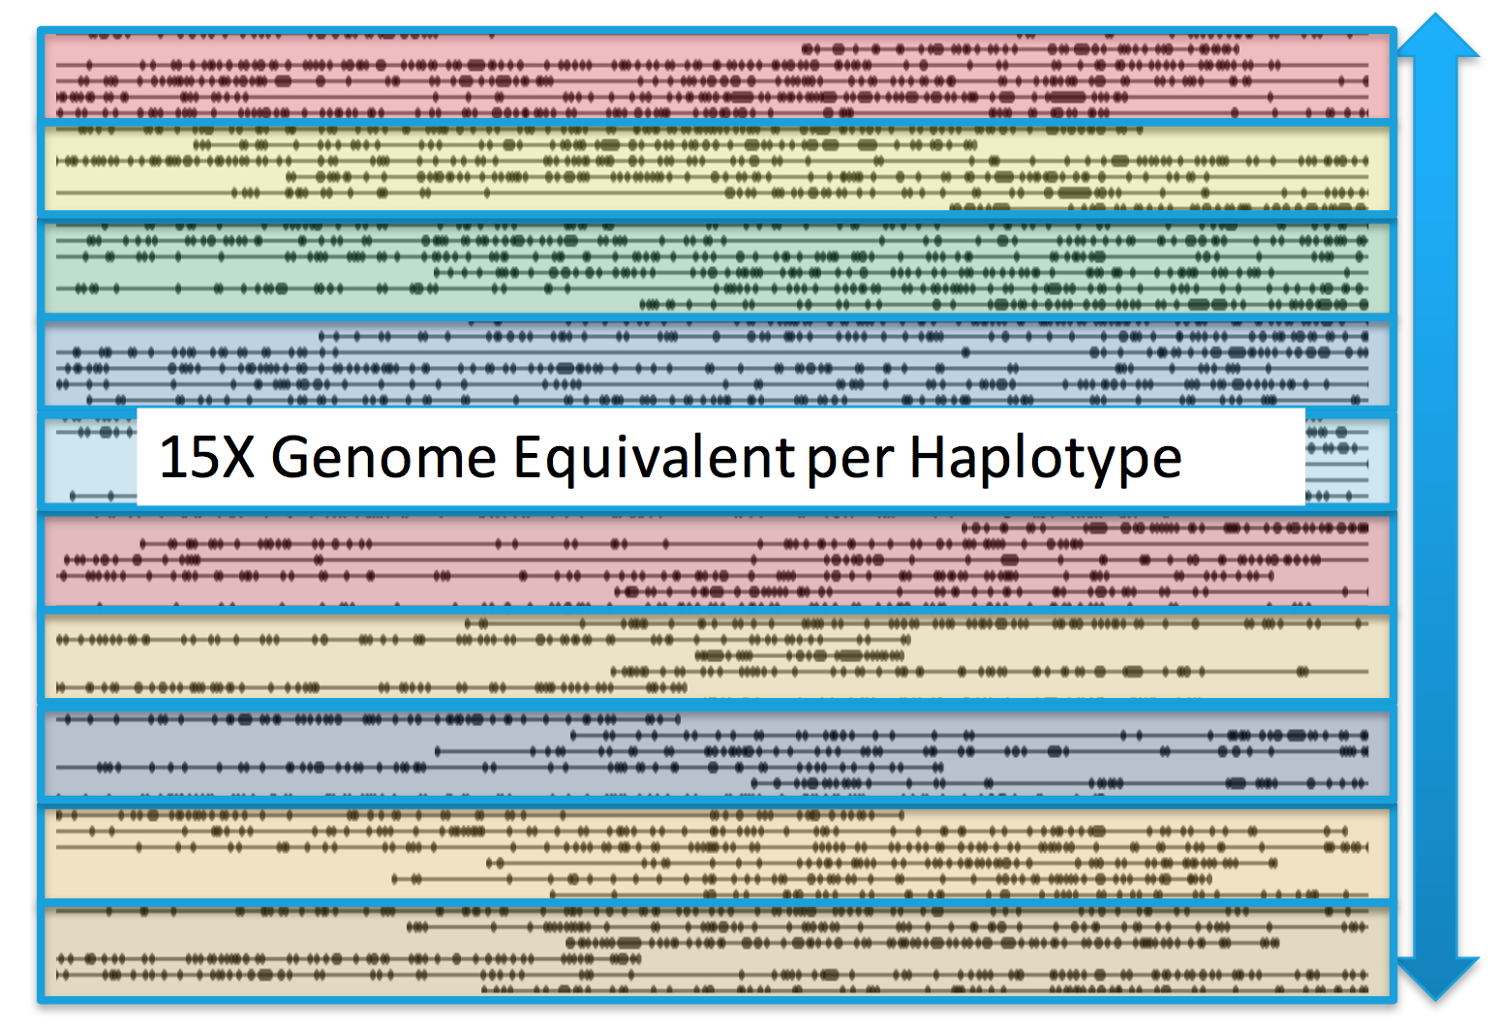
150X Genome Equivalent per locus - decaploid

